Slide 1
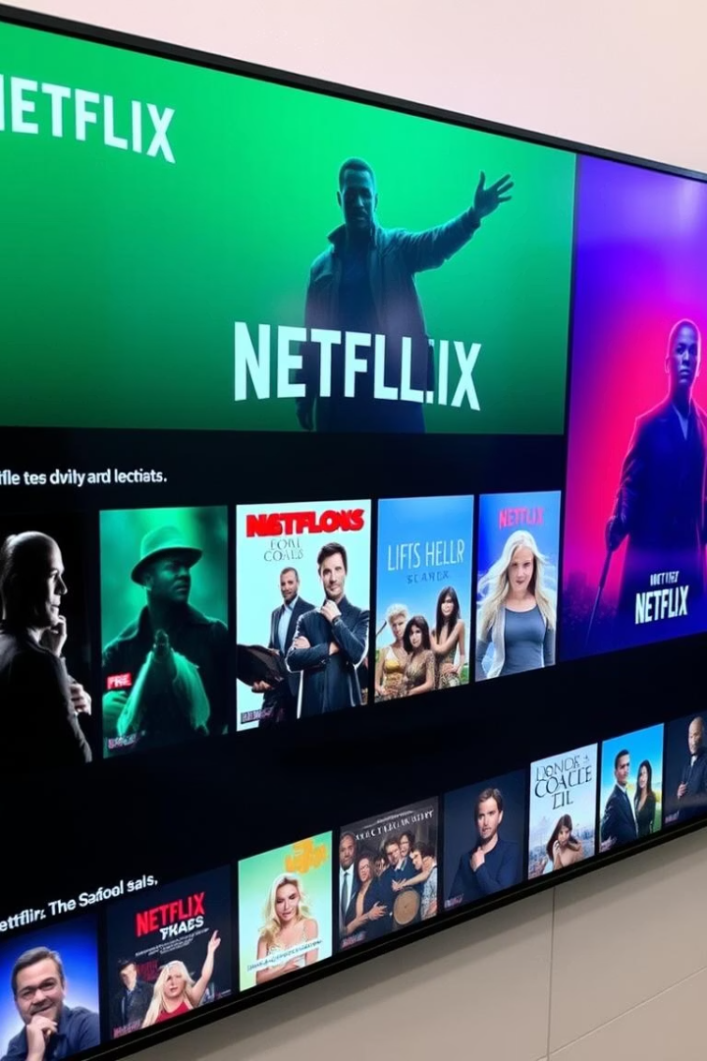

Netflix Movie Recommendations
Building a content-based recommendation system using TF-IDF and Cosine Similarity.
by Shubham Raut

Slide 2

Data Collection
Load Dataset
Key Columns
Read Netflix titles CSV with 8,807 entries and 12 columns.
Includes title, type, director, cast, country, release year, rating, and description.

Slide 3
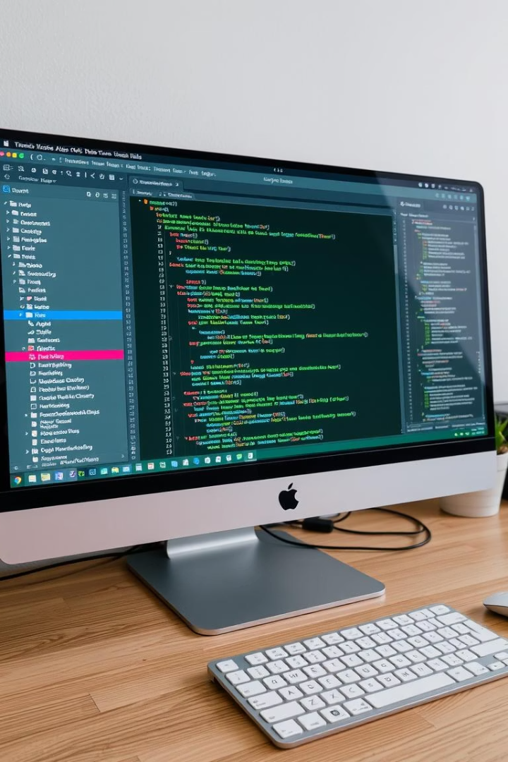
Data Cleaning & Preprocessing
Drop Nulls
Remove Duplicates
Remove rows missing title, type, description, or genre.
Ensure unique movie titles for accurate recommendations.
Combine Text
Create a content field from title, genres, and description.

Slide 4
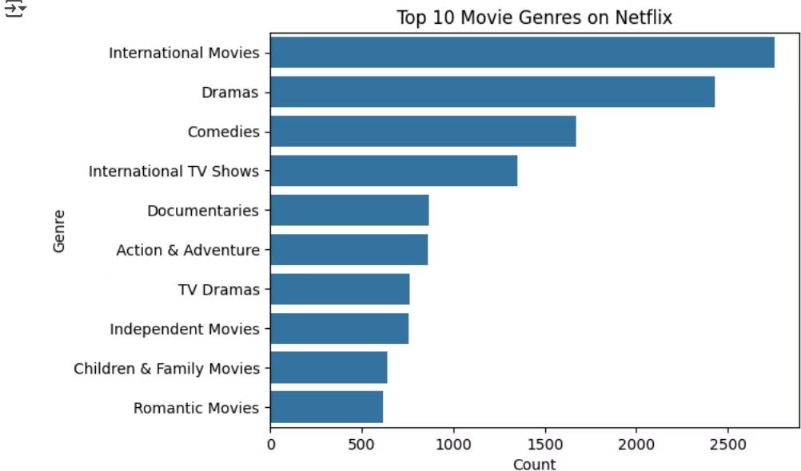
Exploratory Data Analysis
Popular Genres
Release Years
Top 10 genres identified by frequency in dataset.
Movies span from 1925 to 2021, with peaks in recent years.

Slide 5

Feature Engineering: TF-IDF Vectorization
TF-IDF
Matrix
Convert combined text into numerical features removing English stop words.
Generate TF-IDF matrix representing movie content for similarity calculations.

Slide 6
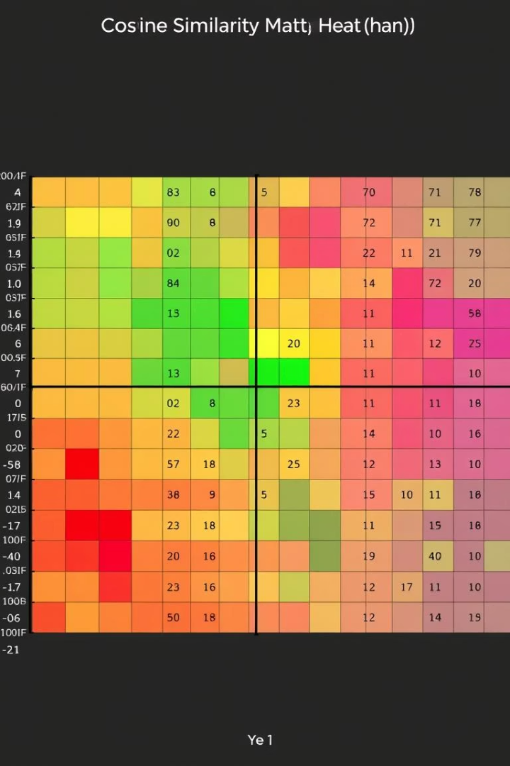



Cosine Similarity for Recommendations
Compute Similarity
Calculate cosine similarity between all movie TF-IDF vectors.
Mapping Titles
Create index mapping for quick lookup by movie title.
Recommendation Function
Return top 10 similar movies based on cosine similarity scores.

Slide 7
Testing the Recommender
Example: Narcos
Example: Kota Factory
Narcos: Mexico
Dealer
Miss Dynamite
Cheese in the Trap
El Cartel 2
Bad Blood
Ganglands
The Great Train Robbery

Slide 8

Conclusion & Next Steps
Built System
Enhancements
Content-based Netflix recommender using TF-IDF and Cosine Similarity.
Future improvements: collaborative filtering and neural embeddings.

